Slide 1









IETE Student Forum
Amrita Vishwa Vidyapeetham
Team Name : NeuroEdge
Team Leader Name : Varshini G S
Track : AIoT (AI at the Edge)

Slide 2


TITLE:
Edge-AI Enabled Real-Time Sepsis Prediction System for ICU Care
MOTIVE:
Sepsis is a life-threatening condition where early detection within the first few hours is critical to reduce mortality.
Existing ICU monitoring systems rely on periodic checks, lab reports, and cloud-based analysis, causing delays and privacy risks.
Our solution uses Edge AI to continuously monitor vital signs like heart rate, SpO₂, temperature, blood pressure, and respiratory rate.
Machine learning models run locally at the bedside (edge devices) to predict sepsis risk in real time.
The system provides instant risk classification and alerts to clinicians through a secure dashboard, enabling faster and proactive intervention.

Slide 3
How is it different from existing ideas?
Traditional systems depend on cloud computation, leading to latency, bandwidth usage, and data privacy concerns.
Our approach performs on-device AI inference (Edge AI), ensuring Ultra-low latency, No continuous cloud dependency, Enhanced patient data security.
Unlike score-based methods (e.g., basic early warning scores), this system uses machine learning with multi-sensor fusion for higher accuracy.
How will it solve the problem?
Continuously collects patient vital signs using wireless sensors.
Processes data locally using trained ML models to calculate sepsis risk in real time.
Automatically classifies patients into Low, Medium, or High risk categories.
Generates instant alerts and visual trends for ICU staff, reducing diagnostic delay.
Works even in resource-limited or network-restricted environments.

Slide 4
Unique Selling Proposition of the Solution
Real-time edge inference (<50 ms latency) enabling instant clinical alerts without cloud delay.
Privacy-preserving design, ensuring no raw patient data leaves the bedside device.
Secure wireless multi-sensor fusion for reliable and tamper-resistant vital sign monitoring.
AI-driven early prediction, moving beyond static rule-based scoring to proactive risk assessment.
Scalable for urban hospitals, optimized for high-density ICU deployments.
Fail-safe edge operation, maintaining sepsis detection even during network or cloud outages.
Seamless integration with existing ICU workflows, requiring minimal infrastructure changes and low deployment cost.

Slide 5
LIST OF FEATURES OFFERED BY THE SOLUTION
Edge – AI based sepsis prediction (no cloud delay)
Multi sensor data fusion for higher accuracy
Instant risk scoring & alert generation
Privacy – preserving encrypted communication
Low-Latency , offline – capable inference
Multi – patient monitoring dashboard
Scalable & cost effective deployment
Clinician – friendly visual insights

Slide 6
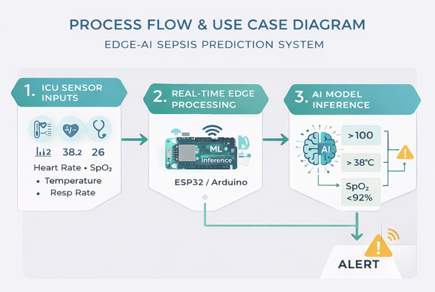
Process flow diagram

Slide 7
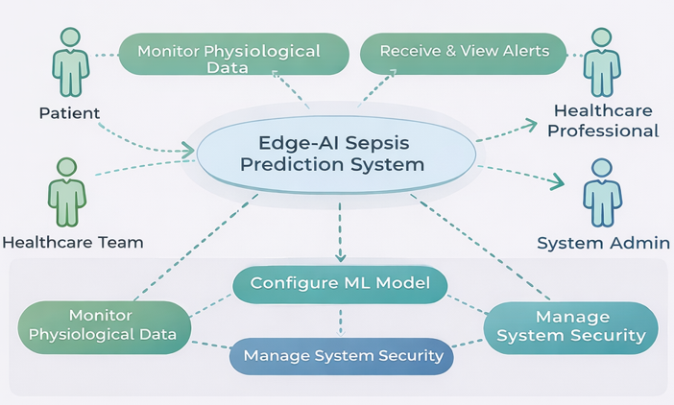
Use Case Diagram

Slide 8
AI TECHNOLOGIES
Machine Learning Model
Random Forest Classifier
Features Used
Body Temperature
Heart Rate
SpO₂
Respiration Rate
Edge Inference​
Real-time prediction executed locally​
<50 ms latency per inference​
Model Training & Validation​
Synthetic + simulated ICU data​
StandardScaler-based preprocessing​
Accuracy, ROC-AUC, Confusion Matrix evaluation​

Slide 9
HARDWARE REQUIREMENTS
Edge Device
  ESP32 / Arduino Nano 33 BLE (Wokwi simulation)
Sensor Emulation (Wokwi)
  Potentiometer → Heart Rate / Blood Pressure
  Temperature Sensor → Body Temperature
  Potentiometer / Slider → SpO₂
  Digital / Analog Input → Respiration Rate
Connectivity
  Secure wireless interface (Wi-Fi / BLE – simulated)
Output Interface
  Serial Monitor / Virtual ICU Dashboard

Slide 10
SOFTWARE REQUIREMENTS
Programming Languages
Python (AI, ML, backend, visualization)
Embedded C / Arduino (edge logic)
Frameworks & Libraries
Scikit-learn, NumPy, Pandas
Flask (secure edge API)
Matplotlib (real-time visualization)
Simulation Tools
Wokwi (IoT simulation)
Google Colab / Local Python

Slide 11
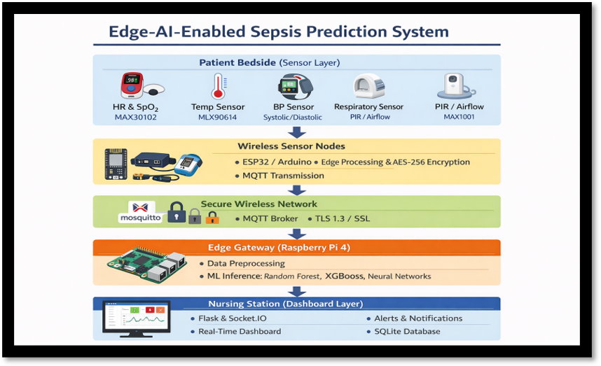
Architecture Diagram

Slide 12
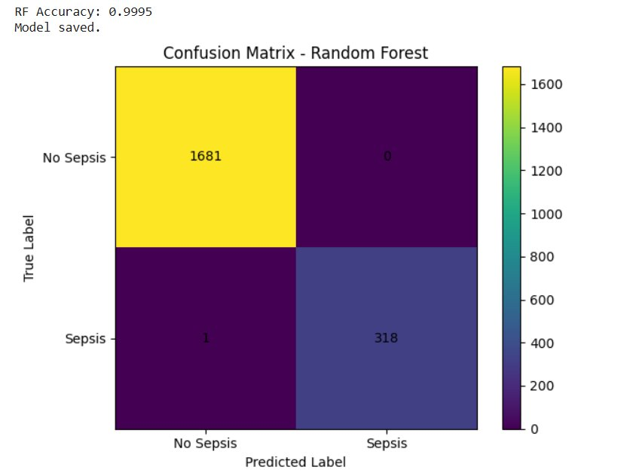
Results
Random Forest Classifier achieved 99.95% prediction accuracy, demonstrating highly reliable early sepsis detection performance on simulated ICU data.

Slide 13
Wokwi-based edge simulation executed successfully, validating real-time multi-sensor data acquisition, and sepsis risk visualization under 3 different conditions Low, Moderate and High based on the risk score
Risk Scoring Criteria
Temperature > 38°C → +1
Heart Rate > 100 bpm → +1
SpO₂ < 92% → +1
Resp Rate > 22 / min → +1
Score | Risk Level
0–1 | LOW
2–3 | MODERATE
≥4 | HIGH
Risk Level | LED | Buzzer
LOW | OFF | OFF
MODERATE | Yellow ON | OFF
HIGH | Red ON | ON

Slide 14
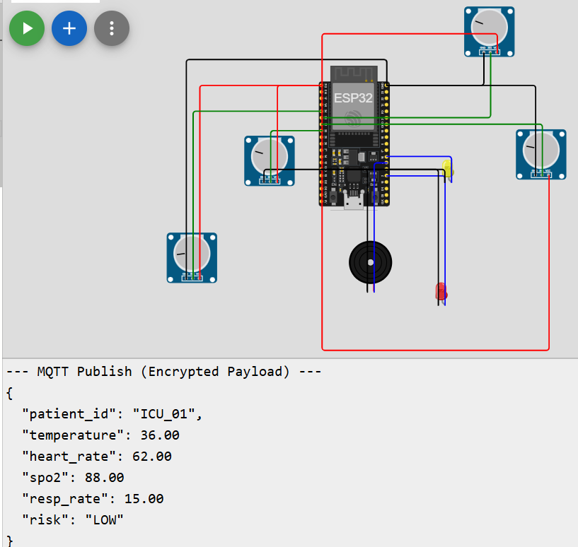
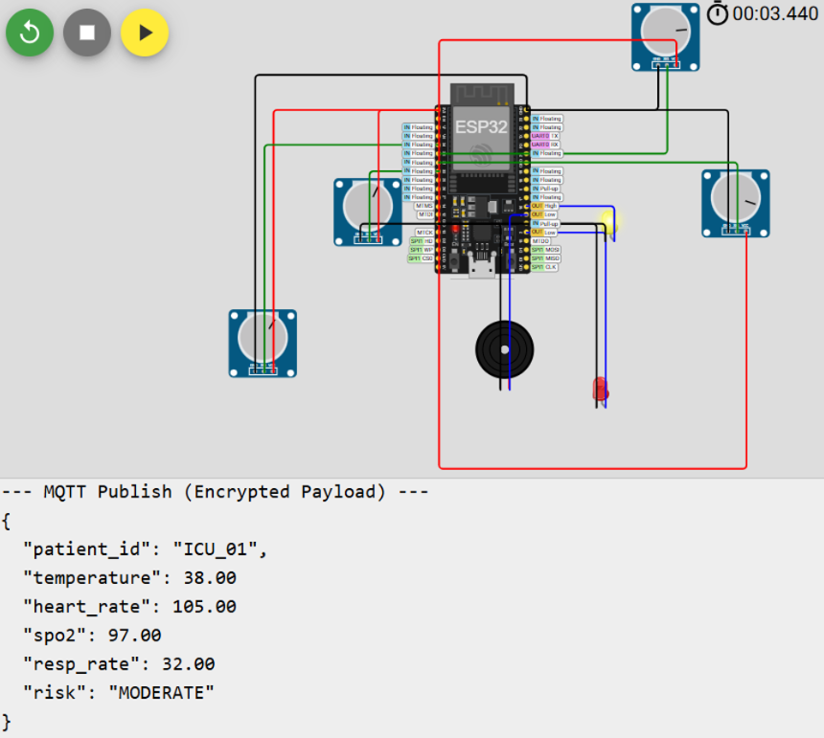

Low Risk Moderate Risk High Risk

Slide 15
Links
Github Link:
https://github.com/varshini-svg/Edge-AI-Powered-Real-Time-Sepsis-Prediction-with-Secure-Multi-Sensor-Fusion-for-ICU-Care.git
Wokwi Simulation Link:
https://wokwi.com/projects/451660277721056257
Google Colab Link:
https://colab.research.google.com/drive/162yEW-i_V1PJNOUFn2NLEagaA5obQ9n0?usp=sharing

Slide 16
Thank You!
NeuroEdge
AIoT

